Slide 1
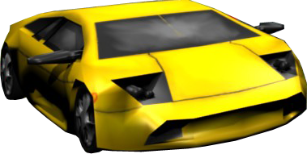
Urban Race
Class Demo
David Saltares Márquez

Slide 2
Index
Description
Schedule
Design
Features
Demo

Slide 3
Description
Pitch: Time attack car racing game
The player has to finish the track on time
Basic car physics
Short playing sessions
Time bonuses are put across the track
Urban and natural environments

Slide 4
Description
Target platforms:
Windows PC
Xbox 360
Windows Phone (if on time)

Slide 5
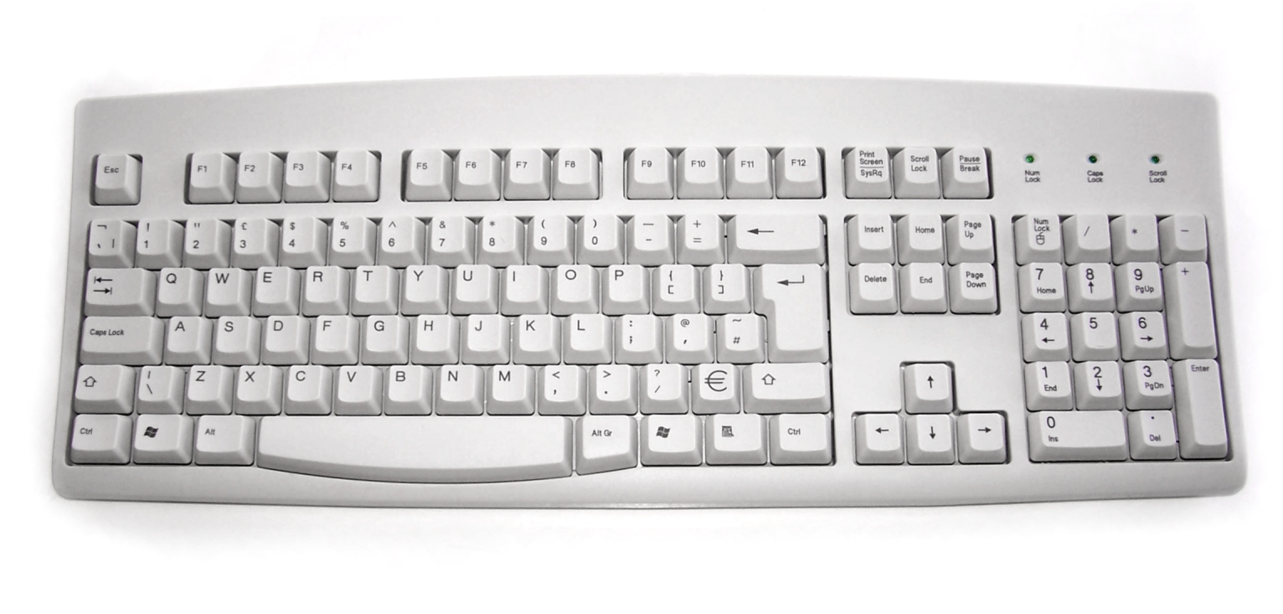
Description
Game controls in Windows PC
Menu
Accelerate
Steer
Brake

Slide 6
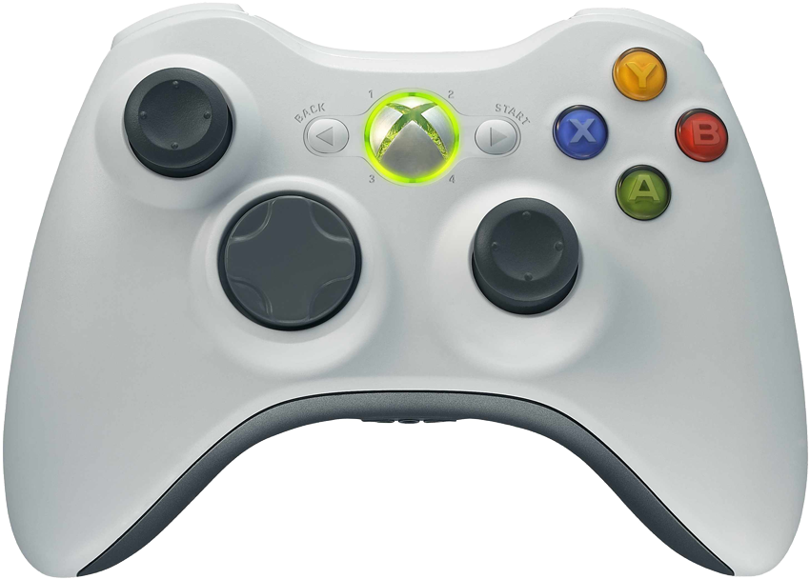
Description
Game controls in Xbox 360
Brake
Accelerate
Steer
Menu

Slide 7
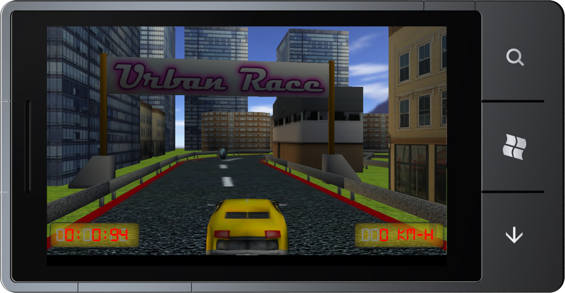
Description
Game controls in Windows Phone 7
Steer
Brake
Accelerate
Menu

Slide 8
Schedule
Learning C# and XNA [Dec 1st]
Log [Dec 2nd]
Blender level loading [Dec 4th]
Car movement [Dec 5th]
Collision detection and physics [Dec 6th]
Game states [Dec 8th]
Input system [Dec 9th]
Skybox [Dec 10th]
Menus [Dec 11th]
Gameplay rules [Dec 13th]
Terrain [Dec 17th]
Sound [Dec 20th]
Content creation [Dec 23th]
Ports (Xbox and WP7) [Dec 28th]
Gameplay tunning [Dec 30th]
Bug fixing [Jan 3rd]

Slide 9
Schedule
Learning C# and XNA [Dec 1st]
Log [Dec 2nd]
Blender level loading [Dec 4th]
Car movement [Dec 5th]
Collision detection and physics [Dec 6th]
Game states [Dec 8th]
Input system [Dec 9th]
Skybox [Dec 10th]
Menus [Dec 11th]
Gameplay rules [Dec 13th]
Terrain [Dec 17th]
Sound [Dec 20th]
Content creation [Dec 23th]
Ports (Xbox and WP7) [Dec 28th]
Gameplay tunning [Dec 30th]
Bug fixing [Jan 3rd]

Slide 10
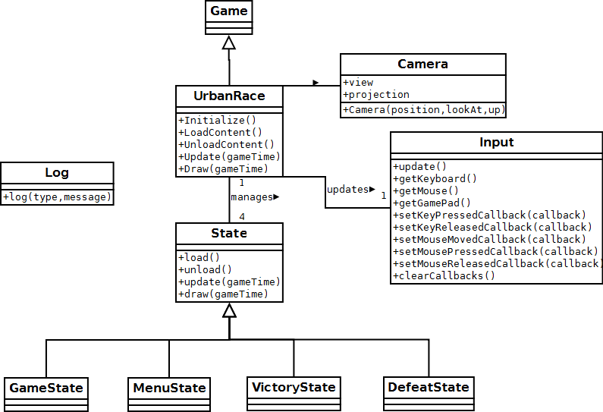
Design
System and game states

Slide 11
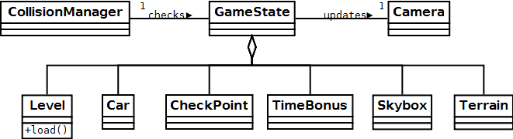
Design
Game state

Slide 12
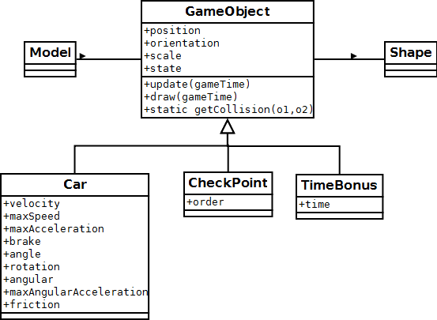
Design
Game objects

Slide 13
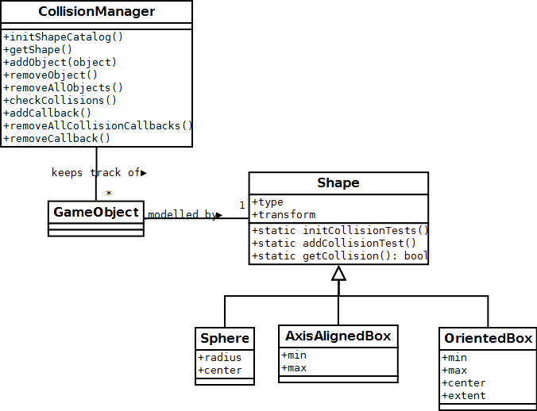
Design
Collision detection

Slide 14
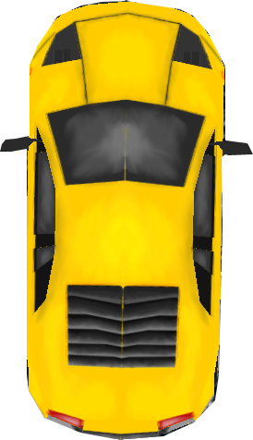
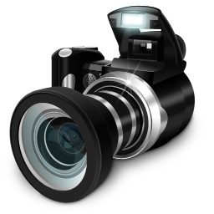
Features: car movement
Acceleration
Angle
Brake/friction
Camera (following car)

Slide 15
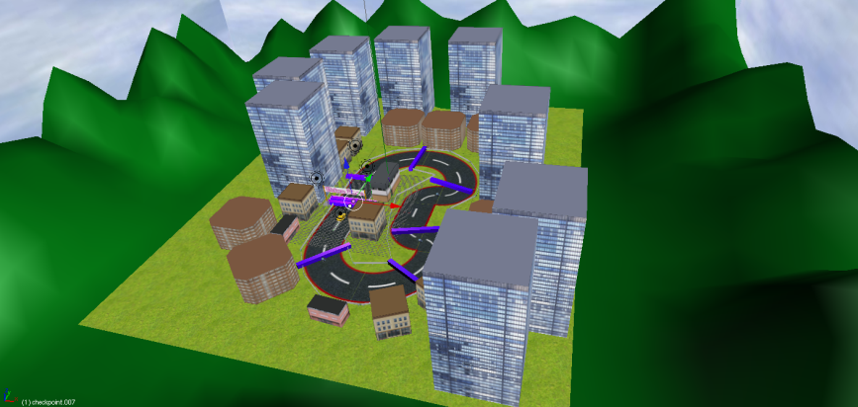

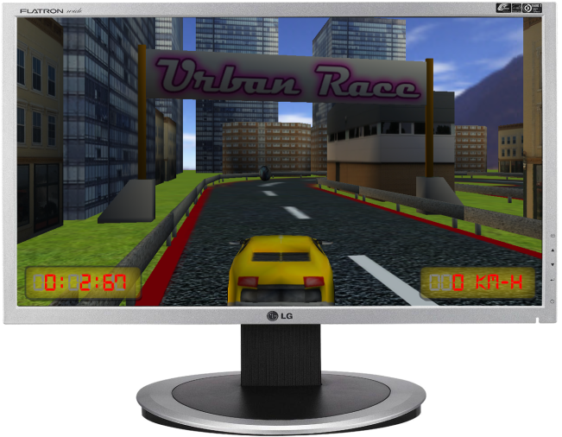
Features: Blender level creation
1. Blender level creation
2. XML exporting script
3. In-game loading system

Slide 16
Features: Collision detection
Each GameObject can have a shape
Several types of shapes
Real time multiple dispatch between shape tests
Broad and extensive passes
Collision callbacks: begin, during, end
Normal vector

Slide 17
Features: Collision detection
Wall: OBB
Collision normal
Car: OBB

Slide 18
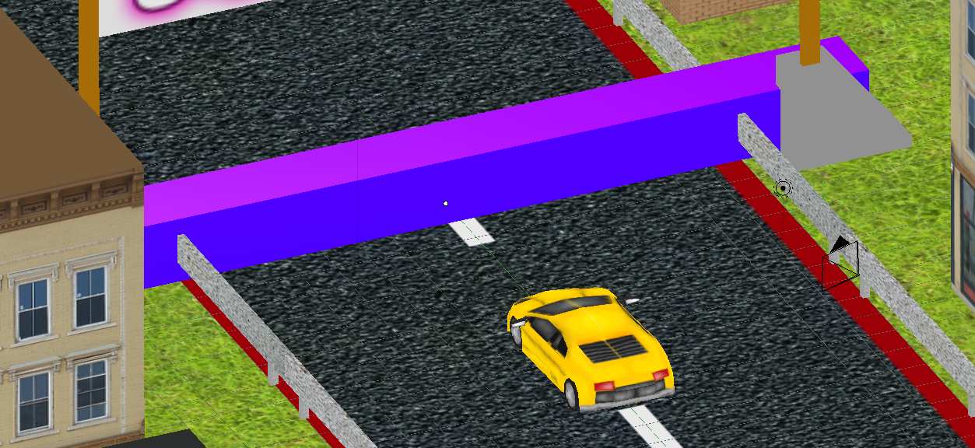
Features: checkpoints
The player has to collect them in order

Slide 19
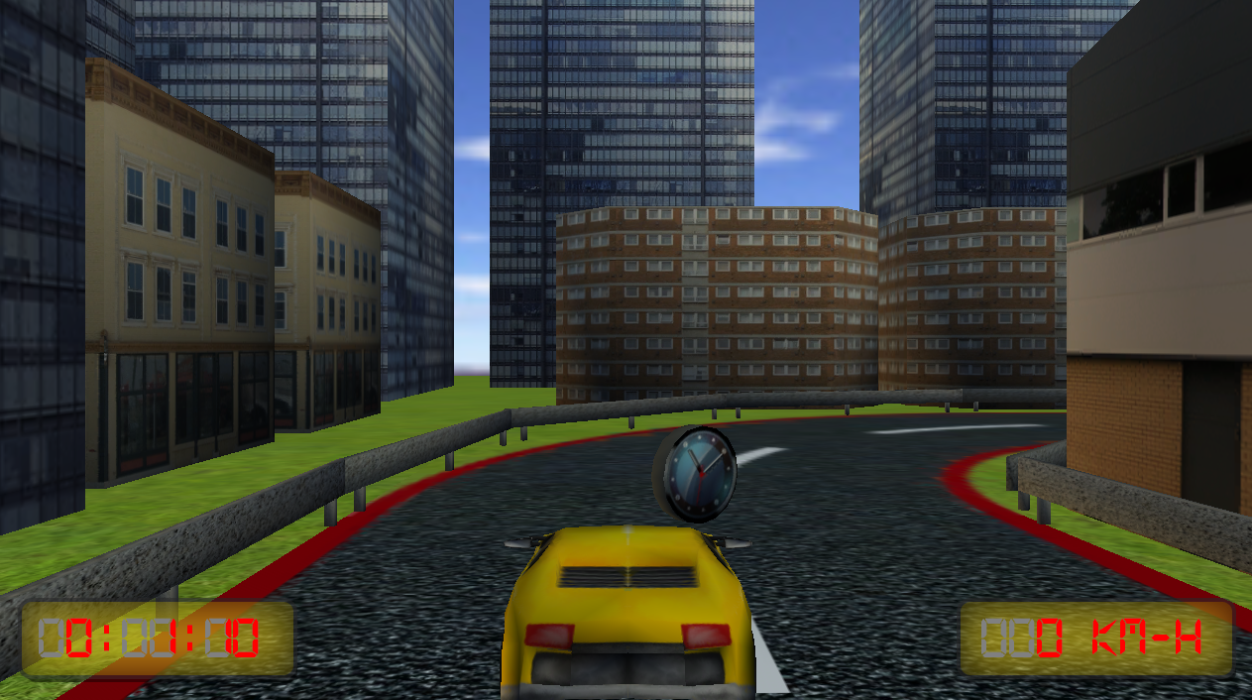
Features: time bonuses
The player has to collect them to obtain time

Slide 20
Demo
Let’s see Urban Race demo running

